Slide 1


Torre de Pisa
Fábio Santos
IPMaia, 16 de Junho 2022
A “Torre de Pisa”, tema conhecido mundialmente que conseguiu influenciar variados tipos de arte.

Slide 2
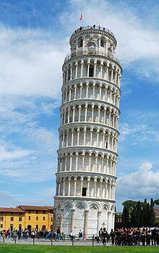
Torre de Pisa
Neste trabalho vai me ser permitido demonstrar aspetos históricos sobre um monumento mundialmente conhecido, a Torre pendente di Pisa, mais conhecida como Torre de Pisa situada em Itália.
https://pt.wikipedia.org/wiki/Torre_de_Pisa#/media/Ficheiro:Leaning_Tower_of_Pisa_(April_2012).jpg

Slide 3
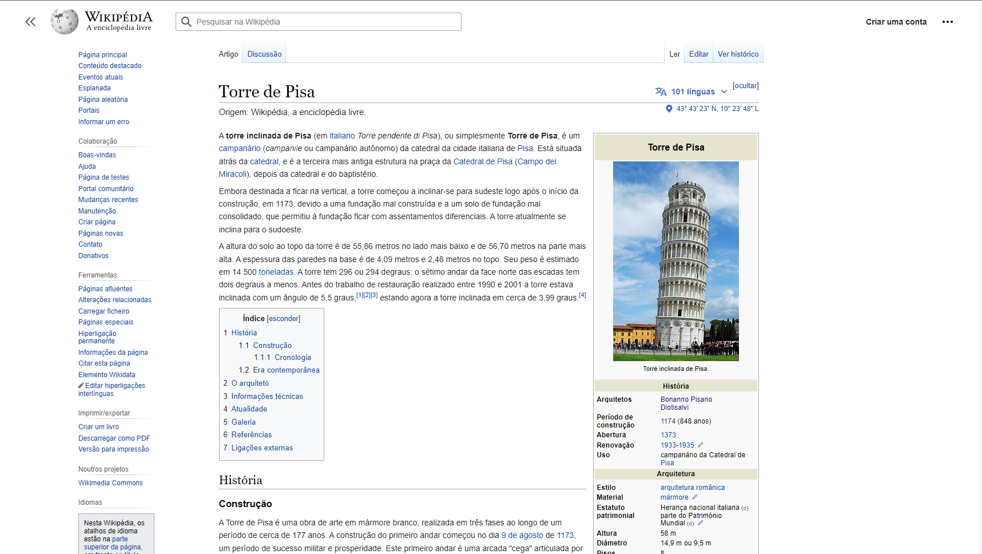
Torre de Pisa
Wikipedia sobre a Torre de Pisa
https://pt.wikipedia.org/wiki/Torre_de_Pisa

Slide 4
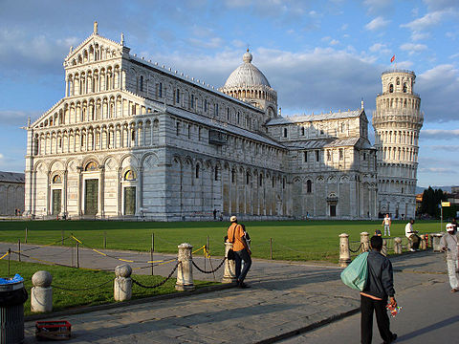
Torre de Pisa
A Torre de Pisa é uma torre sineira da catedral da cidade italiana de Pisa.
Sendo a terceira estrutura mais antiga na praça da Catedral de Pisa, depois da catedral e do batistério.
https://pt.wikipedia.org/wiki/Catedral_de_Pisa#/media/Ficheiro:Pisa-Catedral1.jpg

Slide 5
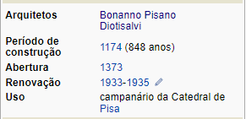
Torre de Pisa - Arquitetos
Devido a longa duração de contrução da Torre de Pisa, o projeto foi passado por diversos arquitetos, dos quais se destacam Bonanno Pisano e Diotisalvi.
https://pt.wikipedia.org/wiki/Bonanno_Pisano
https://pt.wikipedia.org/wiki/Diotisalvi
https://pt.wikipedia.org/wiki/Torre_de_Pisa

Slide 6
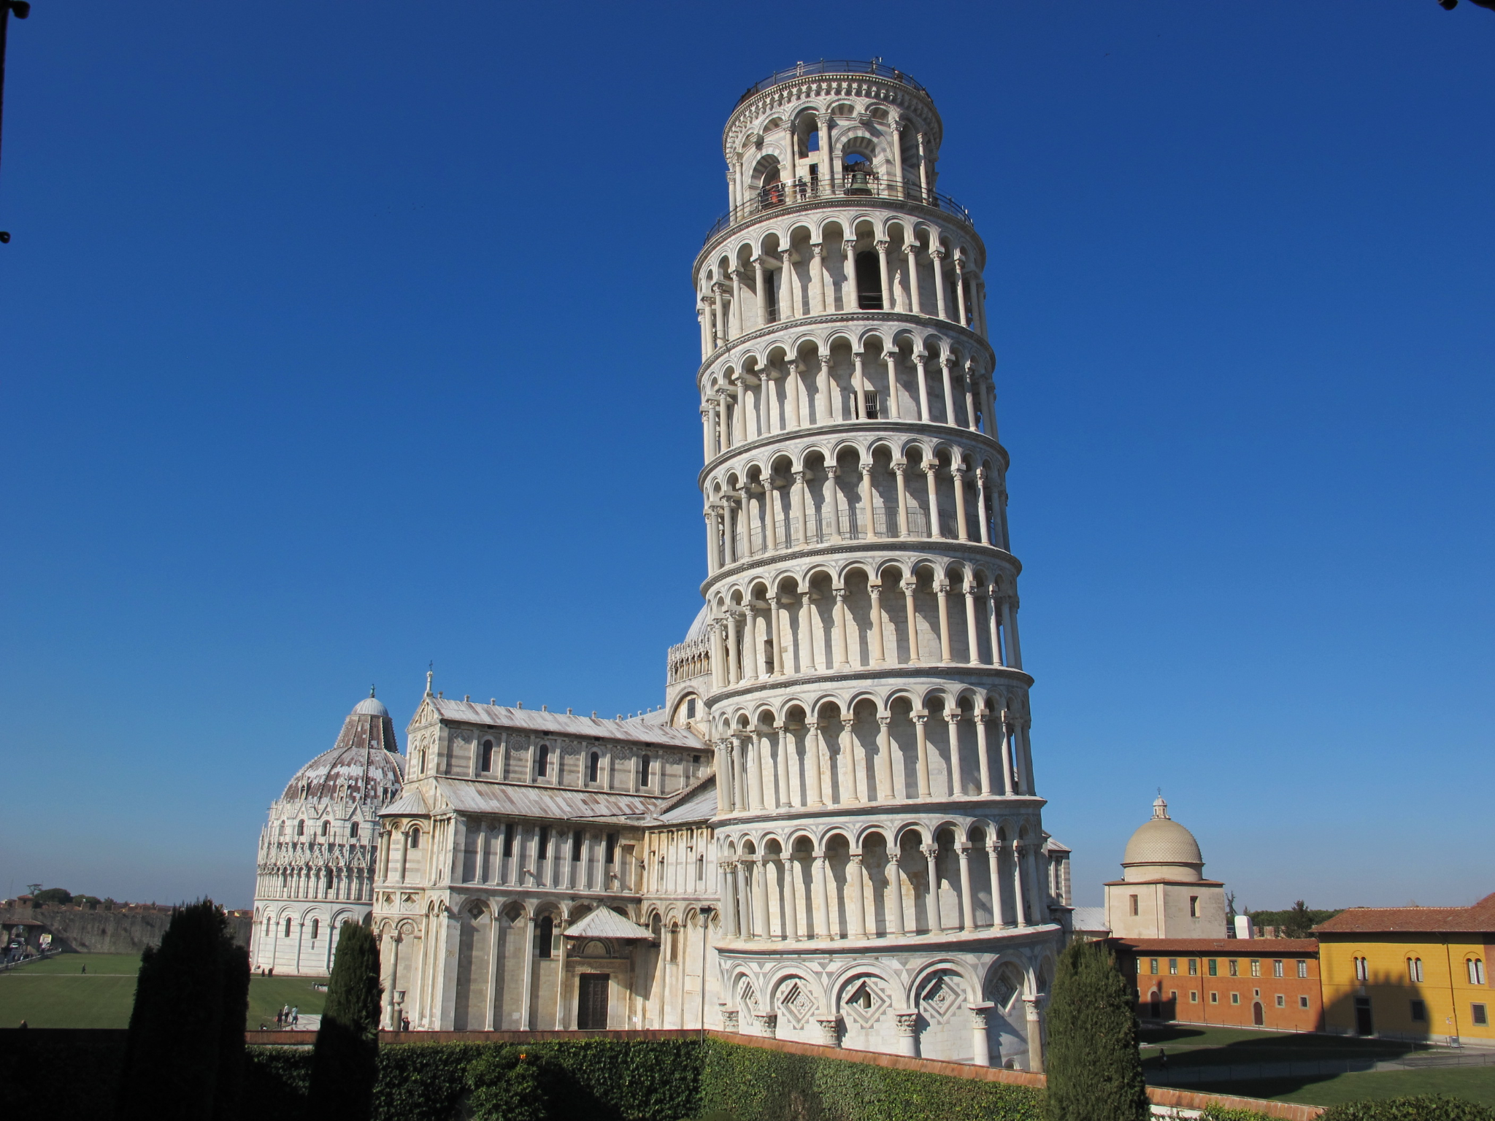
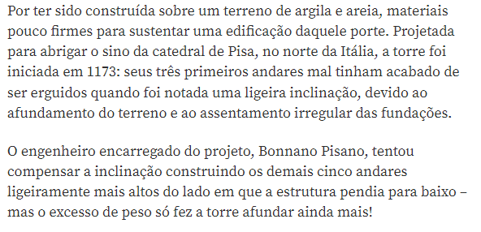
Torre de Pisa - Inclinação
https://super.abril.com.br/mundo-estranho/por-que-a-torre-de-pisa-e-inclinada/

Slide 7
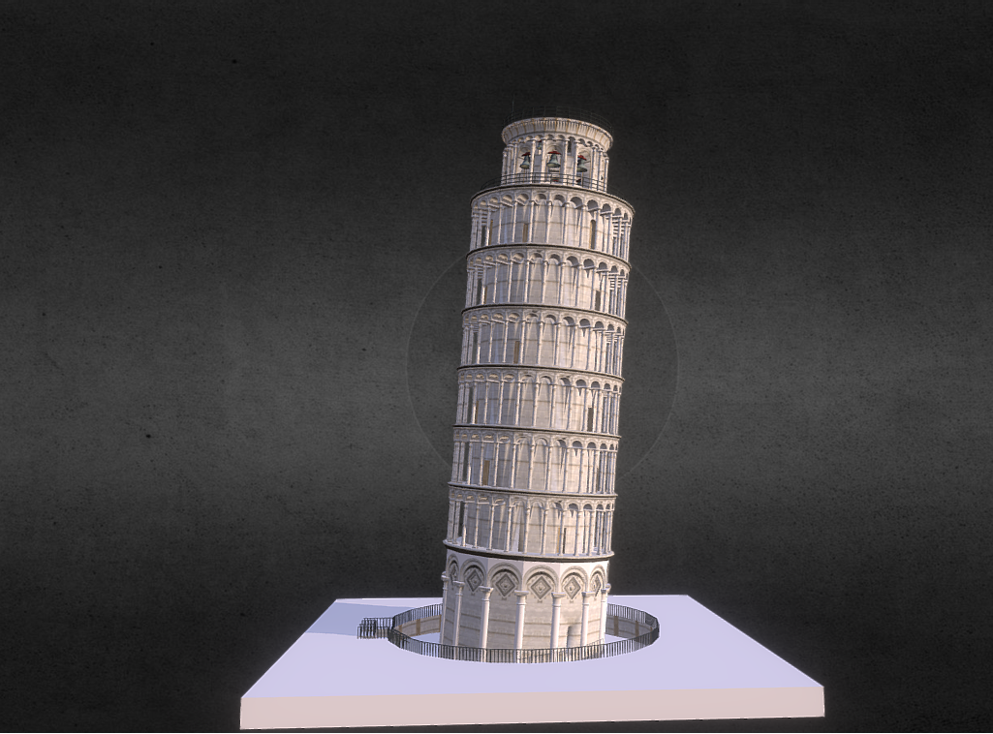
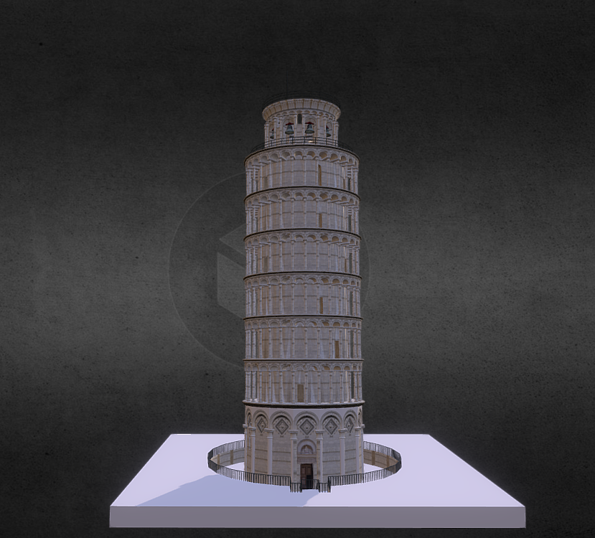
Torre de Pisa - 3D
Vista frontal da
Torre de Pisa
Vista lateral da Torre de Pisa
https://sketchfab.com/3d-models/torre-de-pisa-305053304efa47f18e61e4aec1752f08

Slide 8
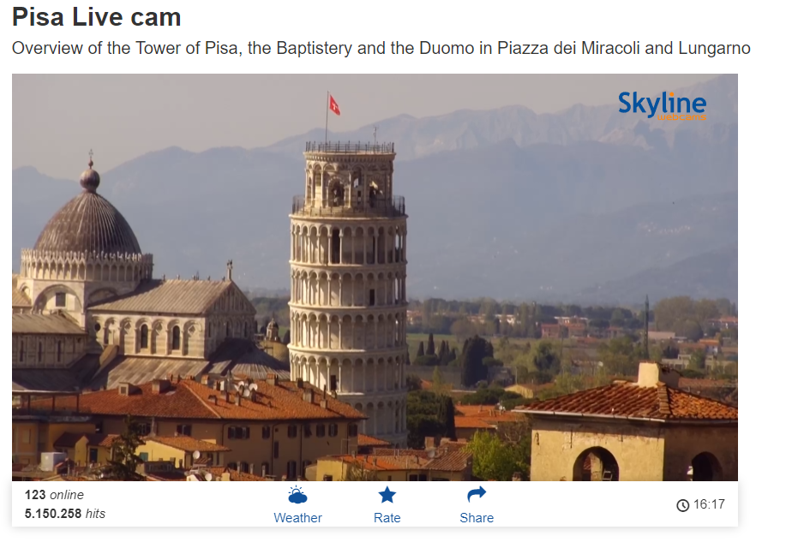
Torre de Pisa - Live WEBCAM
https://www.skylinewebcams.com/en/webcam/italia/toscana/pisa/pisa.html

Slide 9



Torre de Pisa - Filmes
https://www.imdb.com/title/tt0320667/
https://www.imdb.com/title/tt0086393/
https://www.imdb.com/title/tt0083549/

Slide 10



Torre de Pisa - Livros
https://www.fnac.pt/mp20721494/La-Destruccion-De-La-Torre-De-Pisa?Origin=fnac_google
https://www.amazon.com/gp/product/0399117318/ref=dbs_a_def_rwt_hsch_vapi_taft_p1_i0
https://www.amazon.com/Leaning-Tower-Pisa-History-Building/dp/1974502759

Slide 11

Torre de Pisa - Brinquedos
https://www.toysrus.pt/Puzzle-3D-Torre-Pisa/p/K156518?gclid=Cj0KCQjwr-SSBhC9ARIsANhzu14DggAWjyt6ONJ4sQRkbHDwtVeHNlFElNy7hrA46XsX27NYHPuGLzAaAvzyEALw_wcB

Slide 12
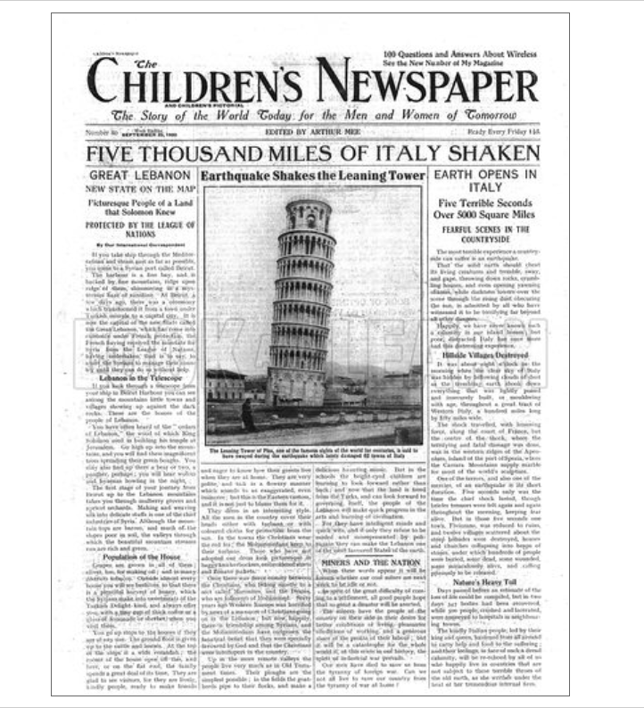
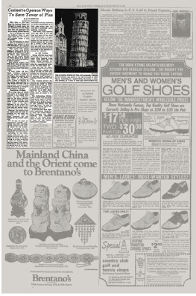
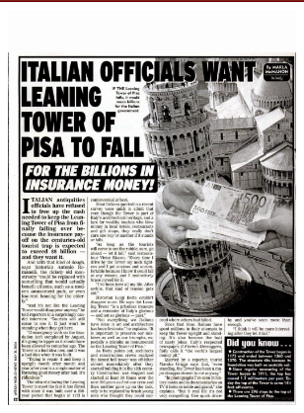
Torre de Pisa - Noticias
http://www.cinedipendente.it/2015/01/e-se-la-torre-di-pisa-la-volessero.html
https://www.lookandlearn.com/history-images/CN200925-001/Earthquake-shakes-the-tower-of-Pisa
https://www.nytimes.com/1972/03/04/archives/contest-to-open-on-ways-to-save-tower-of-pisa.html

Slide 13
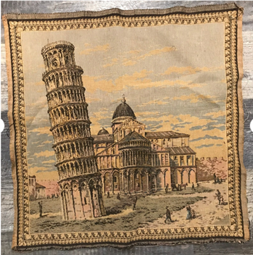

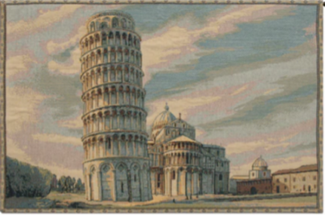
Torre de Pisa - Tapecaria
https://www.saveonwallart.com/torre-di-pisa-italian-wall-tapestry-by-canaletto/amp
https://www.qbillyon.com/index.php?main_page=product_info&products_id=170403
https://pt.aliexpress.com/item/1005002354106988.html

Slide 14
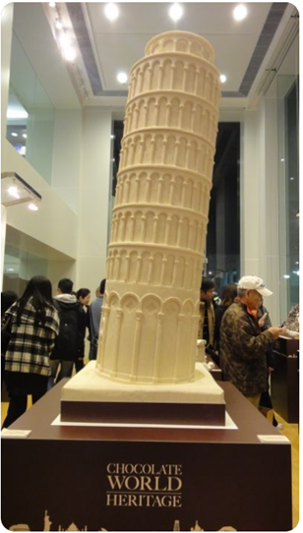
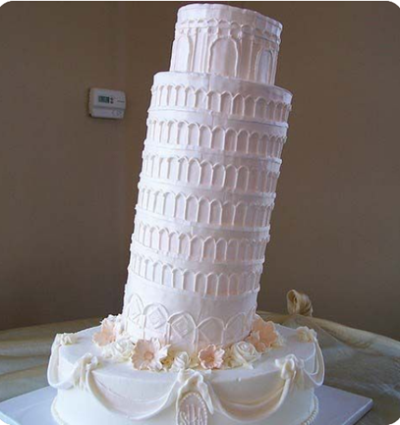
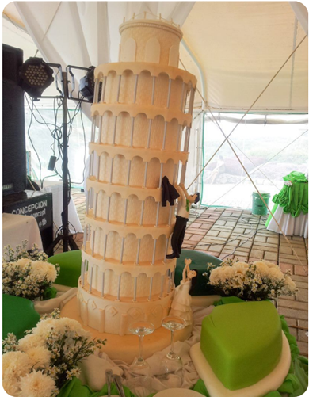
Torre de Pisa - Bolos
https://www.pinterest.pt/pin/384987468143479516/?mt=login
https://www.pinterest.pt/pin/29414203807566522/
https://www.pinterest.nz/pin/318207529902613207/

Slide 15
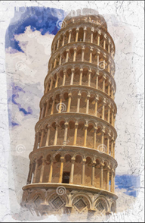
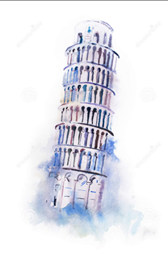
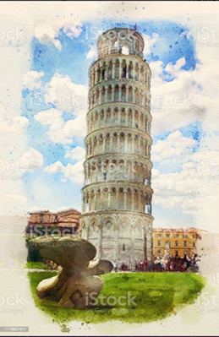
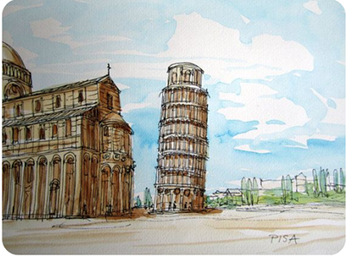
Torre de Pisa - Aguarelas
https://pt.dreamstime.com/aquarela-de-torre-inclinada-pisa-em-papel-antigo-da-na-ilustra%C3%A7%C3%A3o-do-image187874470
https://pt.dreamstime.com/foto-de-stock-torre-inclinada-do-desenho-da-aquarela-de-pisa-pintura-da-maravilha-do-mundo-do-aquarelle-image70263487
https://www.istockphoto.com/br/foto/torre-inclinada-de-pisa-italy-pintura-da-aguarela-gm1179637617-330171161
https://www.pinterest.es/pin/566468459356251730/

Slide 16
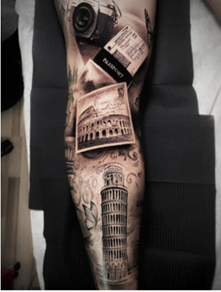
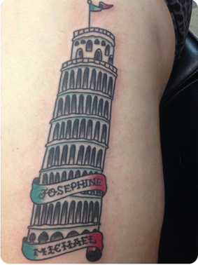
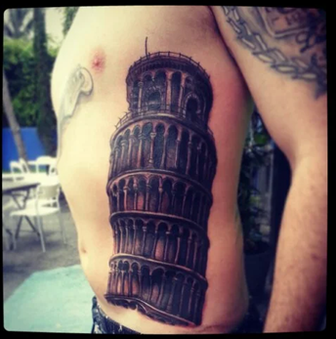
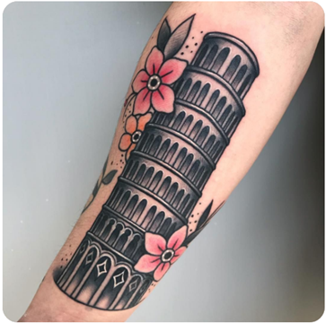
Torre de Pisa - Tatuagens
https://www.pinterest.pt/pin/343962490295264418/
https://www.pinterest.ru/pin/445997169331010942/
https://cbtstudios.wordpress.com/2013/07/19/leaning-tower-of-pisa-tattoo/
https://pt.tattoofilter.com/p/323154

Slide 17
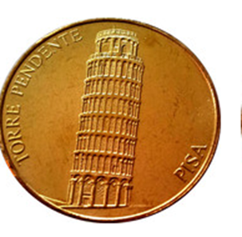
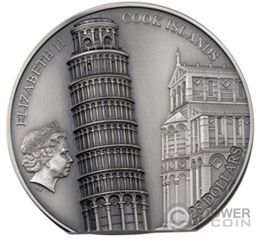
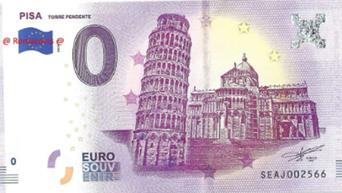
Torre de Pisa - Numismática
https://en.numista.com/catalogue/exonumia37928.html
https://www.powercoin.it/en/cit-coin-invest-ag/6223-leaning-tower-of-pisa-5-oz-silver-coin-25-cook-islands-2022.html
https://www.romacoins.com/Tourist-Banknote-0-Euro-Tower-of-Pisa

Slide 18
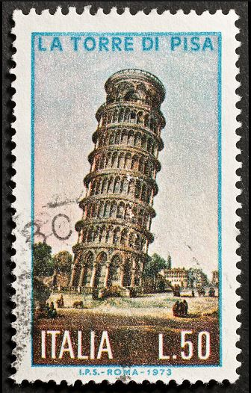



Torre de Pisa - Selos
https://pt.dreamstime.com/ilustra%C3%A7%C3%A3o-stock-torre-de-pisa-do-selo-em-it%C3%A1lia-vetor-image46028669
https://br.freepik.com/vetores-premium/famosa-torre-inclinada-de-pisa-em-italia-no-selo-postal-do-grunge-ilustracao-vetorial_18006824.htm
https://www.istockphoto.com/pt/foto/torre-de-pisa-selo-postal-gm498281783-42044242
https://pt.dreamstime.com/ilustra%C3%A7%C3%A3o-stock-torre-de-pisa-do-selo-em-it%C3%A1lia-image55057200

Slide 19
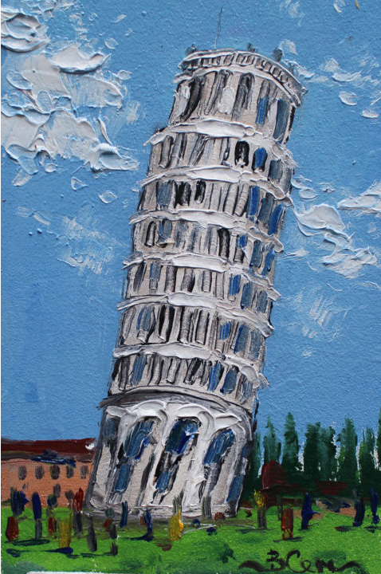
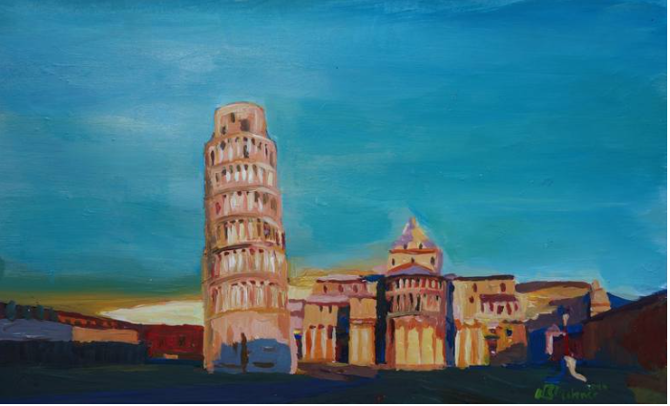
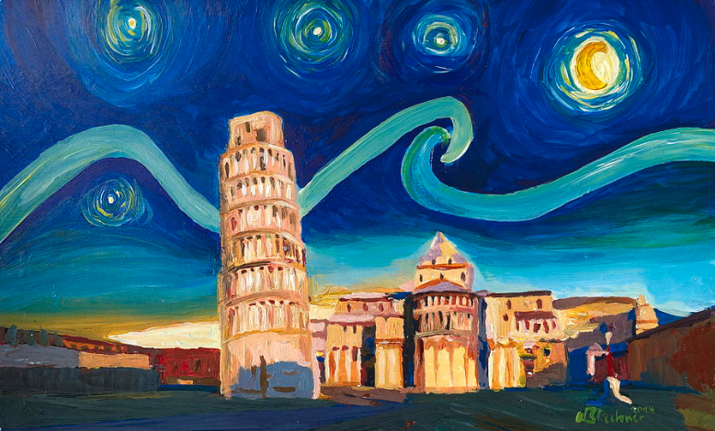
Torre de Pisa - Pinturas
https://www.saatchiart.com/art/Painting-Leaning-Tower-of-Pisa-with-Cathedral-Square-Italy/311983/2147397/view
https://fineartamerica.com/featured/starry-night-in-pisa-with-leaning-tower-van-gogh-inspirations-in-italy-m-bleichner.html
https://www.artmajeur.com/en/sukhanova-vika/artworks/14539160/italy-pisa-tower

Slide 20
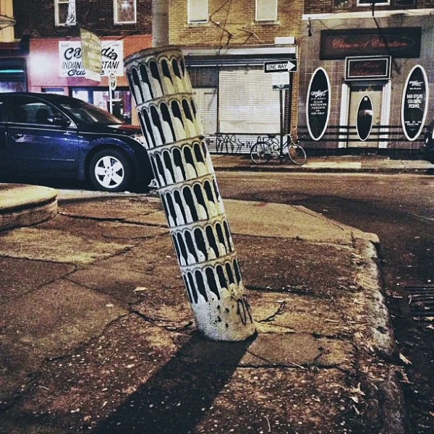
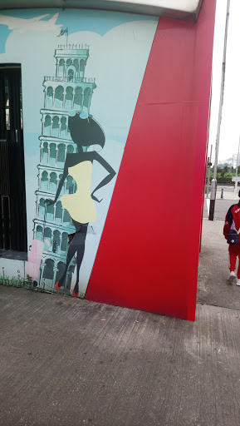
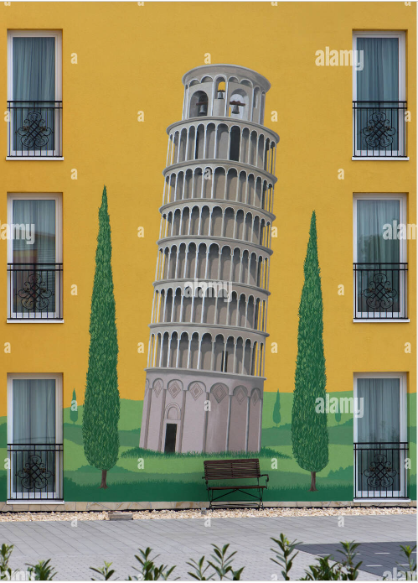
Torre de Pisa - Urban Arte
https://outgress.com/portals/leaning-tower-of-pisa-graffiti.766181/
https://www.alamy.com/wall-painting-the-leaning-tower-of-pisa-on-a-house-facade-baden-wrttemberg-germany-image227037601.html
https://streetsdept.com/2013/01/25/phillys-own-leaning-tower-of-pisa/

Slide 21
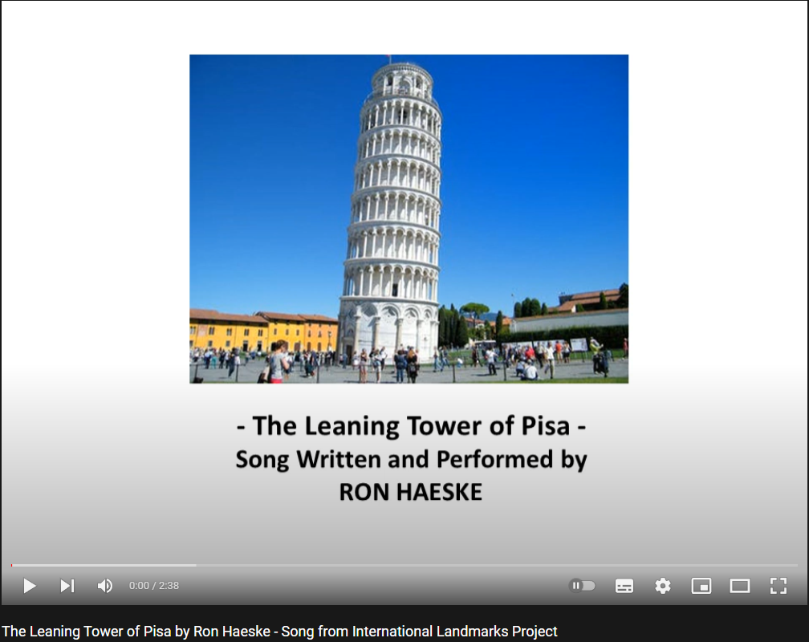


Torre de Pisa - Música
https://www.youtube.com/watch?v=pp6X9f7VBQQ&ab_channel=PaoloDriussi
https://www.youtube.com/watch?v=oMHWKj-j1dM&ab_channel=RonHaeske-Songwriter
https://open.spotify.com/track/4PjJaQbC7BQuhUiJVy8Sjs

Slide 22
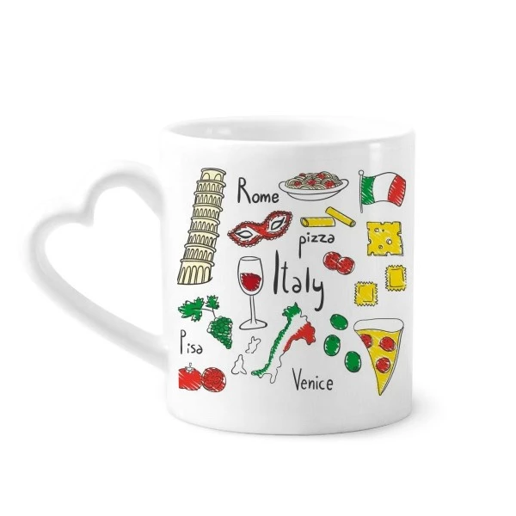
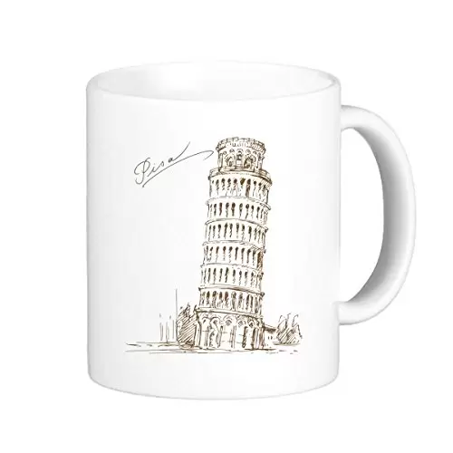
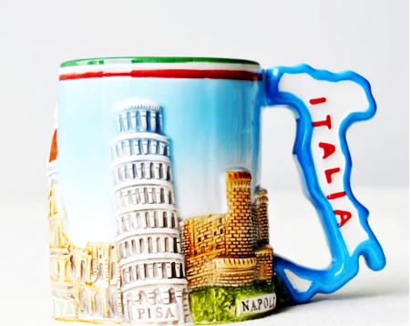
Torre de Pisa - Cerâmica
https://es.aliexpress.com/i/4000617772256.html
https://pt.aliexpress.com/item/32863902573.html
https://pt.dhgate.com/product/leaning-tower-of-pisa-italy-pisa-landmark/443934598.html

Slide 23

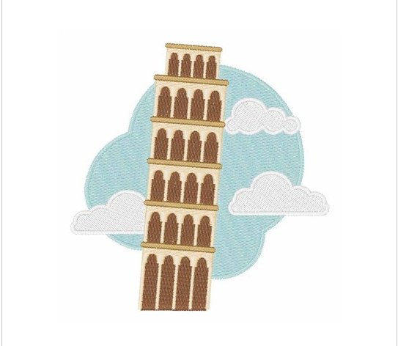
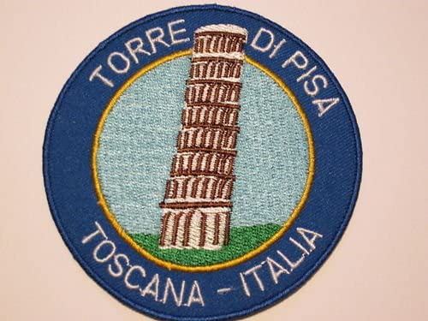
Torre de Pisa - Bordados
https://www.amazon.co.uk/Leaning-Tower-Patch-Torre-Embroidered/dp/B00CQOB9YO
https://www.annthegran.com/prd/designs/hopscotch/italy/1/hs1410021b
https://www.embroiderydesigns.com/productdetails/hopscotch/stockdesign/1/hs1303035a

Slide 24
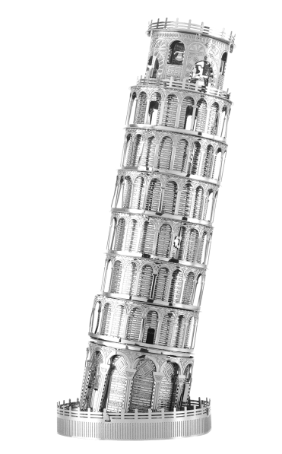
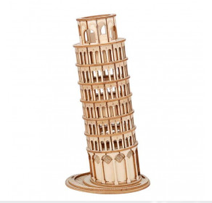
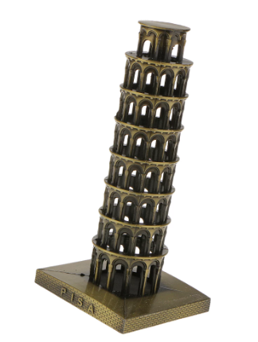
Torre de Pisa - Metal / Ferro forjado / Madeira
https://www.metalearth.com/iconx-leaning-tower-of-pisa
https://computerarenakh.com/robotime-leaning-tower-of-pisa-3d-wooden-puzzle-?tag=ROBOTIME%20LEANING%20TOWER%20OF%20PISA%203D%20WOODEN%20PUZZLE&sort=rating&order=ASC
https://pt.aliexpress.com/item/1005001967093790.html

Slide 25
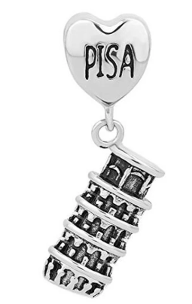
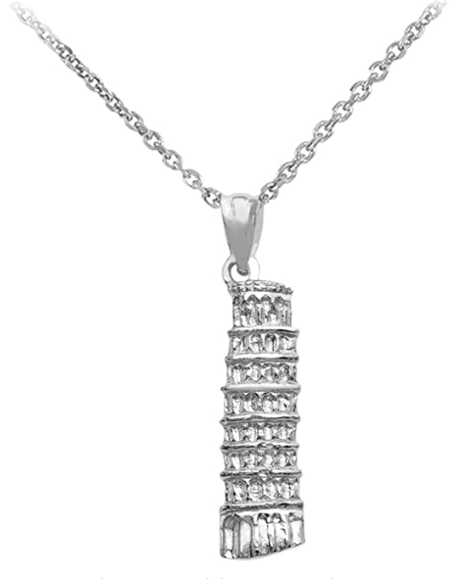
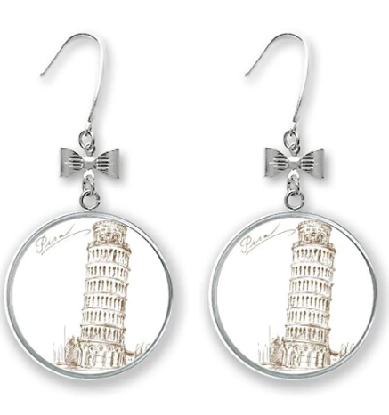
Torre de Pisa - Joalharia
https://www.amazon.com/Leaning-Tower-Pendant-Necklace-Textured/dp/B01LZ8KG1A
https://pt.aliexpress.com/item/4001116272859s.html?gatewayAdapt=glo2bra
https://pt.aliexpress.com/i/32841843796.html?gatewayAdapt=glo2bra

Slide 26
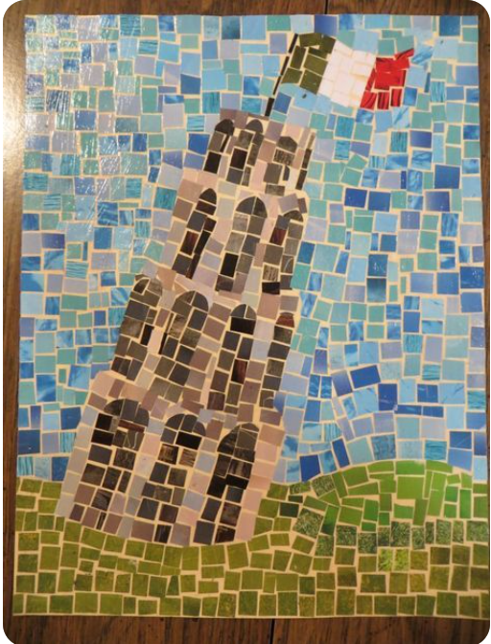
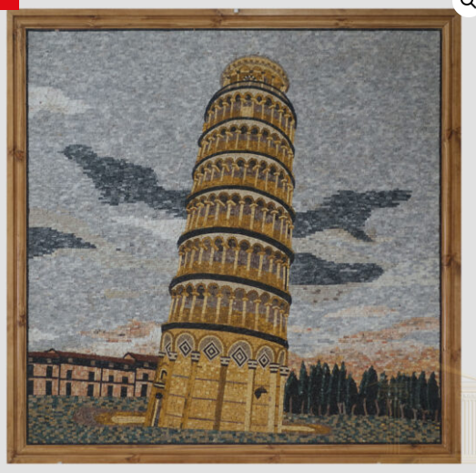
Torre de Pisa - Mosaico
https://www.pisastone.co.uk/shop/sale-items/the-leaning-tower-of-pisa/
https://www.pinterest.ca/pin/576179346065908110/

Slide 27
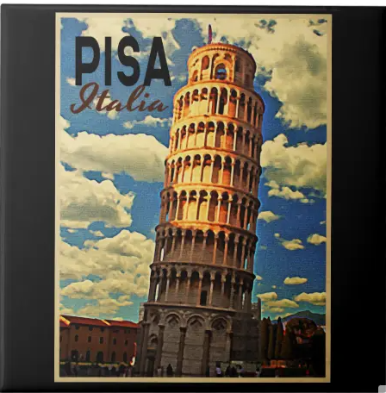


Torre de Pisa - Azulejo
https://www.zazzle.com/starry_night_in_pisa_with_leaning_tower_tile-227898160719878690
https://www.zazzle.com/tower_of_pisa_ltaly_ceramic_tile-227077691557495459
https://www.zazzle.com/a_touch_of_italy_ceramic_tile-227353408877316596

Slide 28



Torre de Pisa - Ilustração
https://www.dreamstime.com/stock-illustration-leaning-tower-pisa-vector-illustration-hand-drawn-cartoon-art-image99063356
https://www.alamy.com/leaning-tower-of-pisa-colored-drawing-realistic-vector-illustration-of-paints-image430961670.html
https://www.istockphoto.com/pt/vetorial/antiguidade-ilustra%C3%A7%C3%A3o-de-torre-de-pisa-gm490400180-75193871

Slide 29


Torre de Pisa - Banda desenhada
http://www.cinedipendente.it/2014/04/thor-polverizza-la-torre-di-pisa.html
http://www.cinedipendente.it/2018/08/superman-raddrizza-la-torre-di-pisa-e.html

Slide 30



Torre de Pisa - Videojogos
https://steamcommunity.com/sharedfiles/filedetails/?id=1828854812
https://angrybirds.fandom.com/wiki/Tower_of_Pisa_Anniversary
https://castlevania.fandom.com/wiki/Bloodlines_Stage_3

Slide 31


Torre de Pisa - Lego
https://ideas.lego.com/projects/6cff2d8d-ddfb-4bcc-b481-ccedb52a5c5d
https://www.amazon.com/LEGO-Architecture-Leaning-Discontinued-manufacturer/dp/B00CN5Y0K6

Slide 32



Torre de Pisa - Porcelana
https://pt.aliexpress.com/item/32652442192.html
https://www.catalogodasartes.com.br/obra/DDGczPAD/
https://pt.aliexpress.com/item/4000613746384.html

Slide 33

Torre de Pisa - Screenshot da exposição
https://www.artsteps.com/view/62ab0bdbb4e870ca2f780ba3/?currentUser

Slide 34
Conclusões e recomendações
Com a conclusão deste trabalho, penso que a Torre de Pisa é um monumento que apesar de ser bastante antigo e a sua construção ter passado por vários arquitetos, não deixa de ser um monumento interessante e que ao longo dos anos o vem demonstrando devido aos imensos turistas que o visitam e através dos outros tipos de arte que são feitos depois de inspirados na Torre de Pisa.
Recomendo que visitem o monumento caso tenham oportunidade e que procurem outras curiosidades sobre a Torre de Pisa.

